Slide 1
Topics (Part 1)
Productivity and Production
Measurement of Productivity
Productivity Index
Productivity Improvement Procedure
Organization by Product Function

Slide 2
Productivity and Production
Productivity is a measure of how much input is required to produce a given output
Productivity = output/input
Productivity = Value of goods & services produced / Value of resources utilized for this production.
Productivity is the measure of how well the resources are brought together in an organization and utilized for accomplishing a given set of objectives.
It can be defined as the output – input ratio within a time period with due consideration for quality.
It is applicable to all production systems

Slide 3
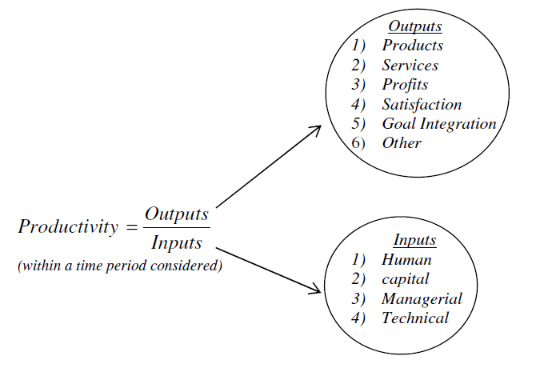
Productivity and Production

Slide 4
Productivity and Production
The formula indicates that productivity can be improved by:
Increasing the outputs with the same inputs
Decreasing the inputs by maintaining the same outputs or
Increasing the outputs and decreasing the inputs to change the ratio favourably.
Production and productivity are different terms and implies different meaning. It should be noted that higher production need not necessarily lead to higher productivity and vice versa.

Slide 5
Productivity
Productivity implies effectiveness and efficiency in individual and organizational performance.
Effectiveness is the achievement of objectives whereas efficiency is the achievement of ends with the least amount of resources.
Managers cannot know whether they are productive unless they first know their objectives and goals and those of the organization.

Slide 6
Production
Production is a process (or system) of converting input into some useful, value added output.
Production is a measure of output produced. The emphasis is not on how well the input-resources are utilized.
Productivity, on the other hand, puts emphasis on the ratio of output produced to the input used. That is, here the focus is on how well the input resource is used for conversion into output.

Slide 7
Productivity Vs Production
Productivity
Relative term
Production
Absolute term
A measure of capacity of system
Increases by utilizing more inputs.
It is expressed in terms of a unit ( No of units or monetary terms)
It may or may not have a unit
Increases by efficient utilization of inputs (4 M’s *)
A measure of efficiency of system
* Money, material, machine and manpower are the 4 M’s

Slide 8
Problem
A company is manufacturing 24,000 components per month by employing 100 workers in 8 hours shift. Calculate the productivity?
Answer
Output in terms of production = 24000 components
Input in terms of man-hours = 100worker s × 8hours × 30days
(assuming 30 days in a month)
= 24,000 man-hours
Productivity = 24,000 components
24,000 − man hours
= 1 component/man hour

Slide 9
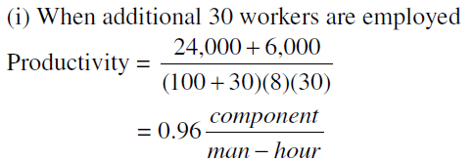
Problem
Suppose the company gets additional order to supply 6000 more components and the management decides to employ additional workers, calculate the productivity when the number of additional workers employed are (i) 30 (ii) 25 and (iii) 20.
Answers

Slide 10
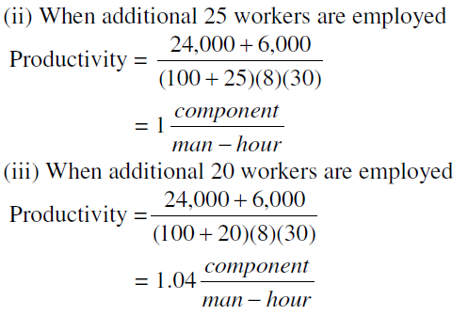
Problem
Note:-
Increase in production does not necessarily mean increase in productivity
Productivity is always associated with the context in which it is calculated. For example, we have calculated labour productivity

Slide 11
Measurement of Productivity
Total productivity
It’s the ratio of aggregate out put to aggregate input
Partial productivity
It’s the ratio of the aggregate output to any single input
Land and building
Materials
Machines
Man power

Slide 12
Objectives of measurement of productivity
To study performance of a system over time.
To have relative comparison of different systems for a given level.
To compare the actual productivity of the system with its planned productivity.

Slide 13
Relation of productivity and profit
Aggregate output = Gross sales = G (in Rs)
Aggregate input = cost = C (in Rs)
Total productivity T_{P} =
Profit = P = G − C
T_{P} = 1 +
when P= 0 , T_{P} =1
when P< 0 , T_{P} <1

Slide 14
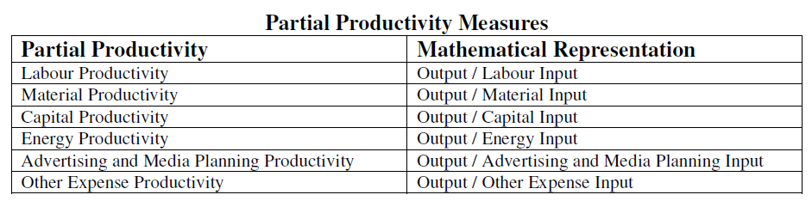
Calculation of productivity
Total Productivity Measure (TPM) – Total outputs to the sum of all tangible input factors (labour, materials, capital, energy, other expenses, etc.)
Total Productivity Measure (TPM) = Total outputs / Sum of all Inputs
Partial Productivity Measure (PPM) - Total output to one class of input.
Total Factor Productivity (TFP) - total output to the sum of associated labor and capital inputs.
Total Factor Productivity (TFP) = Total Output / (Labour + Capital Inputs)

Slide 15
Calculation of productivity
Aggregate output (Z)
Let X_{i} = number of units of product ‘i’ produced during the period.
Y_{i} = the basic period price for product ‘i’ ( in Rs)
Aggregate output Z= ∑ X_{i} Y_{i}
Material input (M)
Let M_{i} = quantity of material ‘i’ used during the period for producing the products
C_{i}= cost per unit of raw material ‘i’ in the same base year
Material input, M= ∑ M_{i} C_{i}
Labour input (L)
Let l_{i} = number of man hours put by labour category ‘i’ during the period under consideration
h_{i} =hourly wage rate
Labour input L = ∑ l_{i} h_{i}

Slide 16


Calculation of productivity
Capital and land input (K)
It can be divided into two parts : Fixed assets and the Current assets
Let Di = Depreciation (Rs) for the fixed asset ‘i’
I = Cost of capital in base period ( percentage)
A = Total working capital in the period ( Rs)
R = Rental or equivalent of the value of land in base period (Rs)
The capital and land input, K = ∑ Di +AI +R
Total productivity = aggregate output /aggregate input
= =

Slide 17
Advantages and Disadvantages of Total Productivity Measure
Advantages | Disadvantages
More accurate representation of the total picture of the company Easily related to total costs Considers all quantifiable outputs and inputs | Difficulty in obtaining the data Requirement of special data collection system

Slide 18
Advantages and Disadvantages of Partial Productivity Measure
Advantages | Disadvantages
Easy to understand and calculate A tool to pinpoint improvement | Misleading if used alone No consideration for overall impact

Slide 19
Advantages and Disadvantages of Total Factor Productivity
Advantages | Disadvantages
Data required for the calculation is relatively easy to obtain from company records Value added approach | No consideration for material and energy input Difficult to relate value added approach to production Efficiency

Slide 20
Productivity index
Material productivity =number of units produced/cost of material
This can be increased by
Proper choice of design
Proper training and motivation of workers
Better material planning and control
Searching for cheaper alternate material etc..

Slide 21
Productivity index
Labour productivity = aggregate output / expenditure from labour
The unit may be number of units/man hours or in monetary terms
This can be increased by
Proper selection of design and process
Proper training
Motivate workers by financial and other incentives
Providing facilities and chances for self development

Slide 22
Productivity index
Capital productivity = turn over / capital employed
This can be improved by
Better utilization of capital resources
Careful make or buy decision
Machine productivity = output / actual machine hours utilized
This can be improved by
Preventive maintenance
Use proper machine settings
Using method study techniques
Using properly skilled and trained workers etc.
General measure of productivity
Aggregate productivity = output /(land+labour+material+capital+other inputs)

Slide 23
Factors Influencing Productivity
Controllable factors (Internal Factors)
Product
Plant and equipment
Technology
Materials
Human factors
Work methods
Management style
Financial factors
Uncontrollable factors (External factors)
Natural Resources
Government Policy
Political Stability

Slide 24
Ways to Improve Productivity
Productivity of any system can be improved by proper use of resources and optimum utilization of system or processes. These include the following.
Technology Based
Acquire new technology
Automation in assembly
Modern maintenance techniques
Energy technology
Flexible Manufacturing Systems (FMS)

Slide 25
Ways to Improve Productivity
Employee Based
Financial and non-financial incentives at individual and group level
Suggestion scheme
Safe work-place
Workers participation in management

Slide 26
Ways to Improve Productivity
Material Based
Material Planning and control
Purchasing, logistics
Material storage and retrieval
Source selection and procurement of quality material
Waste elimination
Use of Automated Guided Vehicle (AGV) for material transportation

Slide 27
Ways to Improve Productivity
Process Based
Methods engineering and work simplification
Job design, Job evaluation, Job safety
Human factors engineering
Product Based
Value analysis and value engineering
Product diversification
Standardization and simplification
Reliability engineering
Promotion

Slide 28
Ways to Improve Productivity
Management Based
Management style
Communication in the organization
Work culture
Motivation
Promoting group activity

Slide 29
Productivity improvement procedure
Improving the existing method of plant operation
Use of method study and work measurement procedures
The steps involved in it are
Gather all information about the existing methods
Present it in form of charts and diagrams
Do critical examination of these data (why, when , who and how)
Develop improved methods

Slide 30
Productivity improvement procedure
Design of part
Simplify the design
Standardize the materials, tools, procedures, etc ..
Efficient system of quality control
Use better and economic material

Slide 31
Productivity improvement procedure
Tolerance and specifications.
Designers keep tight tolerances.
Lack of consideration of the cost factor, knowledge of production processes and process capability
Designers should interact with production engineers and cost analysis group

Slide 32
Productivity improvement procedure
Effective utilization of materials
The utilization of material should be increased by taking improvement measures in
Design stage
Process or operation stage

Slide 33
Productivity improvement procedure
Process of manufacture
Selection of proper process
Use of proper tools, equipments ,parameters etc

Slide 34
Productivity improvement procedure
Set up and tools
- Use of special tooling depends upon
The quantity to be produced
Chance of repeated orders
The amount of labour involved
Amount of capital requirements
- the productivity will improve by
Reduction in set up time
Design of tooling to use full capacity of machines

Slide 35
Productivity improvement procedure
Working conditions
Lighting
Control of temperature
Adequate ventilation
Control sound
Promote orderliness, cleanliness and good house keeping
Proper waste disposal
Provide protective equipments

Slide 36
Productivity improvement procedure
Material handling
Use mechanical equipments
Proper planning and scheduling
Proper maintenance of equipments and training to workers
Plant layout
It should facilitate smooth flow of materials and men
It should reduce distance moved by men and materials
Storage places should be properly arranged to reduce searching and handling

Slide 37
Benefits of increasing productivity
For management
to earn good profit
to have better utilization of resources
to stand better in the market
For workers
higher wages
better working conditions, improved morale
higher standards of living
job security and satisfaction

Slide 38
Benefits of increasing productivity
For consumers
better quality goods at reduced prices
more satisfaction
To government
more revenue by taxation
improvement in economy
better utilization of resources
increased per capita income
development of the nation

Slide 39
Topic (Part 2)
Material Management

Slide 40
Material management
Materials are one of the main inputs.
It accounts for the 50 to 85% of the total cost of production.
Any savings in the material leads to significant increase in profit.
This is a basic function which directly adds value to the product.
In modern industrial organizations it has a very important place.

Slide 41
Definition
Material management is the planning, directing, controlling and coordinating those activities which are concerned with materials and inventory requirements, from the point of their inception to their introduction into the manufacturing process.
It begins with the determination of materials schedule and ends with issuance to production to meet customers demand as per schedule and at the lowest cost .
Material management deals with controlling and regulating the flow of material in relation to the changes in variables like demand, prices, availability, quality, delivery schedules etc.

Slide 42
Objectives of Material Management
Minimizing cost of materials
To procure and provide materials of desired quality when required, at the lowest possible overall cost of the concern
Receiving and controlling material safely and in good condition.
Identification of surplus stocks and taking appropriate measures to reduce it.
To cut down the costs through simplification, standardization, value analysis, import substitution etc.
To train personnel in the field of materials management in order to increase operational efficiency.
Efficient record keeping and prompt reporting

Slide 43
Functions of Material Management
Planning function
Translation of the sales projection into long term requirements of the materials
Adjust the material requirement as per updated production plan
Arrange the facilities required for the materials management.
Production control
Determining requirements of materials and parts to be purchased and manufactured
Schedules of production and purchasing
Issue work order to departments and purchase order to suppliers
To dispatch the materials to the production department.

Slide 44
Functions of Material Management
Purchasing
Selection of acceptable suppliers and issue of purchase order
To expedite the delivery of materials to meet the inventory requirements
To look for new materials and suppliers
Inventory and stores control
Requisition of materials according to requirements at appropriate time
Keep updated records of the materials received, issued and balance
Do physical verification of materials

Slide 45
Functions of Material Management
Shipping /physical verification
To receive, verify and store finished goods
Pack and label finished goods
To prepare shipping documents
Report about the shipment to the accounting department and sales department
Material handling
To handle in-plant materials
Maintenance of material handling equipments

Slide 46
Functions of Material management
Transportation/ traffic control
To carry raw materials from the suppliers to plant
To carry finished goods to customers
To control routes and rates of hired vehicles
To maintain the fleet of delivery vehicles

Slide 47
Factors Providing Economy in Material Management
Volume of purchases
Nearness to sources of materials
Design and engineering of the product
Inspection
Make or buy decision
Disposal of scrap

Slide 48
Inventory Control
Inventory is the list of movable goods which directly or indirectly used in the production of goods for sale.
Inventory is money kept in the store room in the form of raw material, in-process material and finished goods
“Inventory control refers to the process whereby the investment in materials and parts carried in stock is regulated within the predetermined limits set in accordance with the inventory policy established by the management”
It is the scientific method of finding how much stock should be maintained in order to meet the production demands at the minimum cost.

Slide 49
Inventory Control
Classification
Direct inventories
Raw materials
In process inventories (work in progress)
Purchased parts
Finished goods
Indirect inventories - will not be part of product
Tools:- machine tools and hand tools
Supplies:- accessories of machines, cleaning materials, lubricants, office stationary.

Slide 50
Need for Inventories (Functions or Advantages)
To ensure against delays in deliveries due to variation in lead time
To allow for possible increase in output due to variation in demand
Maintain smooth and efficient production flow
To keep better customer relations
To take advantage of quantity discounts
To utilize advantage of price fluctuations
To ensure against scarcity of materials in the market
To have better utilization of men and machinery

Slide 51
Determining Inventory Level
Objective is to minimize inventory cost and maximize profit
Variables which affect level of inventory are
Order quantity
Lead time
Safety stock
Reorder point

Slide 52
Determining inventory level
Order quantity
The quantity of materials ordered in a single order. It should be decided after considering cost (EOQ)
Lead time
Time Interval between initiating the order and the material is actually received.
It consists of
time taken to deliver purchase order to seller
time for the seller to get or prepare the inventory for dispatch
time taken for transportation to and reception of inventory by the customer

Slide 53
Determining inventory level
Safety stock
The use rate and lead time are varying because
supplier may fail to keep delivery promise
the forecast of use rate may be inaccurate
So extra inventory is needed in order to avoid shortage. This is called reserve stock, safety stock or buffer stock
It should be optimum depending upon
Lead time demand
Carrying charges
Importance of items

Slide 54
Determining inventory level
Reorder point
This indicates the time (level of inventory) at which the purchase order should be initiated and if not done so, the production may stop due to shortage.
Eg: Reorder point
= safety stock + (lead time *consumption rate)
= 100 units + ( 1 month* 200 units/month)
= 300 units

Slide 55
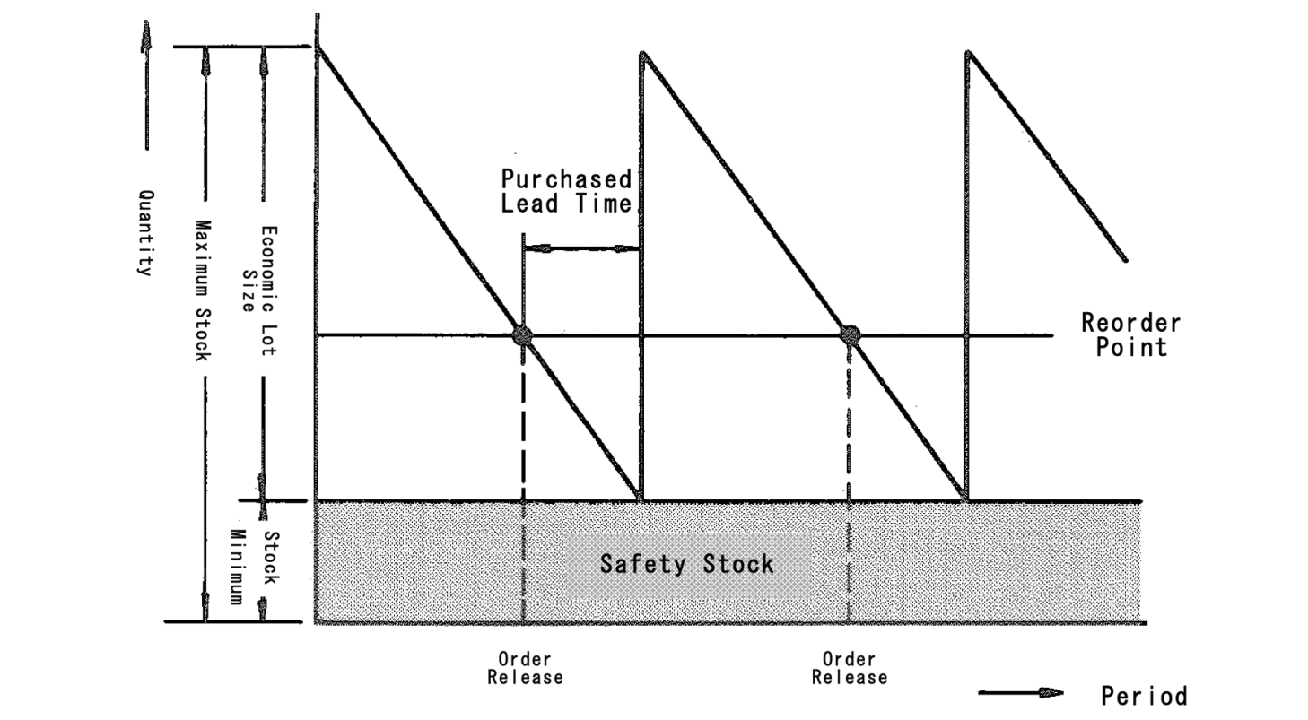
Inventory Vs time

Slide 56
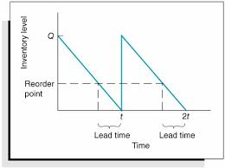
Without safety stock

Slide 57
Inventory Models
Inventory Models seek to find the best balance between finance, production & marketing.
When to order and how much to order.

Slide 58
Inventory Models
Static Inventory Models
Static applies when one decision is allowed, about how much to buy for a constrained marketing window such as seasonal goods, perishable goods like vegetables, bread etc.
In simple, only one order can be placed to meet the demand.
Repeat orders are either impossible or too expensive.

Slide 59
Inventory Models
Dynamic Inventory Models
Dynamic situations require continuous decisions about how much to order at different points in time, ie. repeat orders can be placed.
a) Deterministic models
demand and lead time of an item is constant, ie. known exactly
Purchase model
Production inventory model
b) Probabilistic models
Variation in demand and lead time

Slide 60
Inventory cost
Total inventory cost = Ordering cost + Carrying cost (Holding cost)
Cost of ordering = Cₒ (Rs)
Order quantity =q
Unit cost of ordering = Cₒ / q
If ‘s’ is the annual demand, then
Annual Ordering cost= Cₒ / q * s
Annual Carrying cost =Cu * i * q/2
Cu = Unit purchase cost
i = Interest rate
q/2 = avg. inventory level

Slide 61
Economic Order Quantity (EOQ)
The economic order quantity is the size of an inventory order which minimizes the inventory cost. The inventory cost is the sum of procurement cost and carrying cost.
To determine EOQ two extreme views are encountered:
Order for very large lots (Produce in very large lots) to minimize the procurement cost (to minimize set up cost)
Order for every small lots (produce in very small lots) to minimize the storage cost or carrying cost.

Slide 62
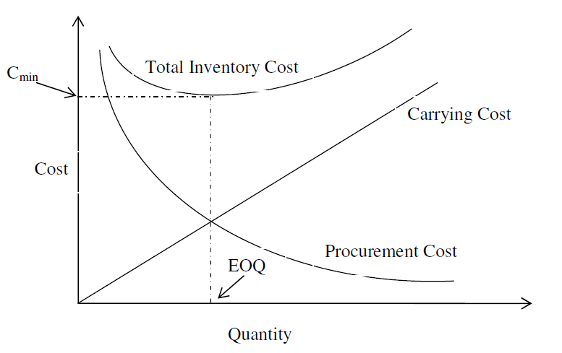
Economic Order Quantity (EOQ)
Procurement cost =
Carrying cost
Purchasing Model with No Shortage
Assumptions
Fixed demand rate ( fixed production rate)
Instantaneous replacement (Lead time = 0)
No shortage is permitted.

Slide 63
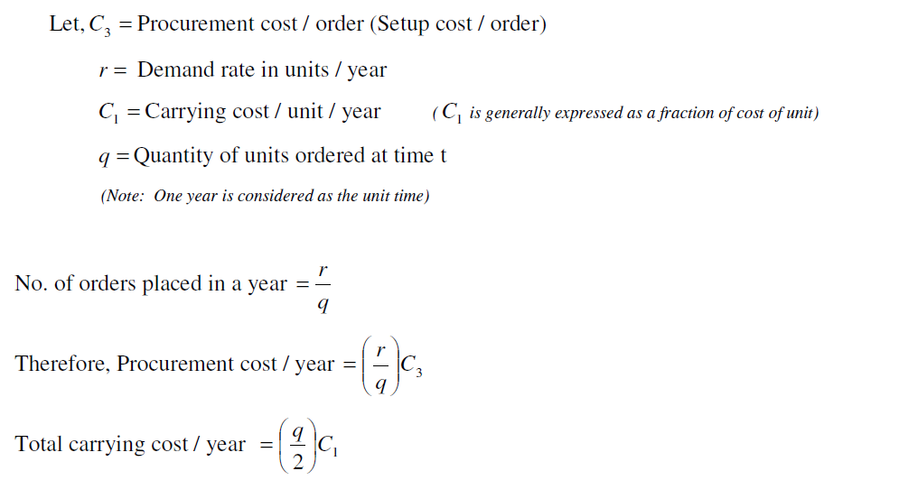
Economic Order Quantity (EOQ)

Slide 64
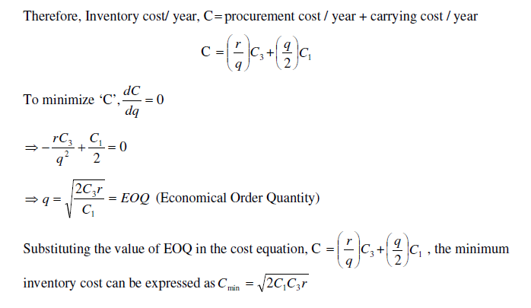
Economic Order Quantity (EOQ)

Slide 65
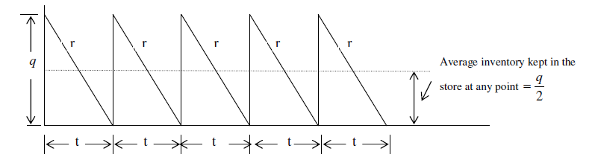
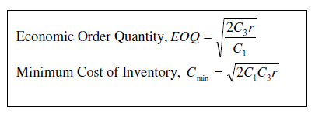
Economic Order Quantity (EOQ)

Slide 66
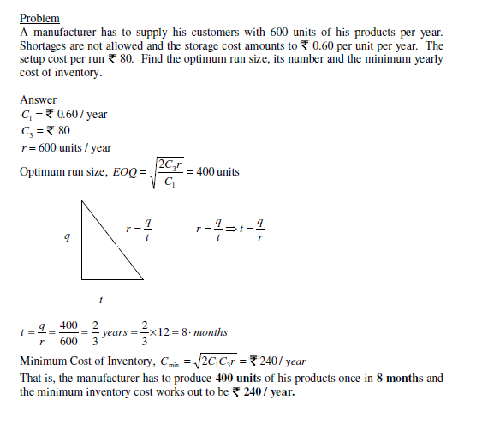
Economic Order Quantity (EOQ)

Slide 67
Material Requirement Planning (MRP)

Slide 68
Material Requirements Planning (MRP)
Material Requirement Planning (MRP) refers to the basic calculations used to determine component requirements from end item requirements.
It also refers to a broader information system that uses the dependence relationship to plan and control manufacturing operations.
MRP is a technique for determining the quantity and timing for the acquisition of dependent demand items needed to satisfy master production schedule requirements.

Slide 69
Material Requirements Planning (MRP)
Computer-based information system for ordering and scheduling of inventories, i.e. what is needed, how much is needed, and when is it needed
Functions of MRP system
Control of inventory levels
Assignments of priorities for components
Determination of capacity requirements at a detailed level

Slide 70
Objectives of MRP
Inventory reduction
Reduction in the manufacturing and delivery lead times
Realistic delivery commitments
Increased efficiency

Slide 71
MRP Inputs
MRP Processing
MRP Outputs
Changes
Order releases
Master
schedule
Planned-order
schedules
Primary
reports
Exception reports
Bill of
materials
Planning reports
MRP computer
programs
Secondary
reports
Performance-
control
reports
Inventory
records
Inventory
transaction

Slide 72
MRP Inputs
Master Production Schedule (MPS) – States which end items are to be produced, when they are needed, and in what quantities. It controls the timing and quantity of production for products or product families
Bill of Materials (BOM) – a listing of all of the raw materials, parts, and sub-assemblies needed to produce one unit of a product
Inventory Records – includes information on the status of an item during the planning horizon, eg. quantity, supplier, order lead time, lot size

Slide 73
MRP Outputs
Primary Reports
Planned Orders Schedule - indicating the amount and timing of future orders
Order Releases - Authorization for the execution of planned orders
Changes - revisions of due dates or order quantities, or cancellation of orders

Slide 74
MRP Outputs
Secondary Reports
Performance-control reports - Evaluation of system operation, including deviations from plans and cost information
Planning reports - Data useful for assessing future material requirements
Exception Reports - Data on major discrepancies encountered

Slide 75
Benefits of MRP
Improved customer service
Quicker response to changes in demand
Better machine utilization
Greater productivity
Reduction in lead time
Reduction in work- in- process
Reduction in past due orders
Elimination of annual inventory
Reduction in safety stock
Increase in productivity
Capacity constraints are better understood

Slide 76
ABC Analysis
ABC analysis, also known as Selective Inventory Control is a business term used to define an inventory categorization technique often used in materials management.
It can be observed that in a typical industrial situation nearly 10% of items have 70% of the annual inventory consumption, 20% of the items have 20% of annual inventory consumption, and 70% of the items have only 10% of the annual inventory consumption.

Slide 77
ABC Analysis
Since 70% of the annual consumption of inventory is covered by only 10% of the items in the inventory, these items deserve highest attention and are classified as ‘A’ items.
Similarly 20% of the items covering 20% of the inventory investment are B class items and require moderate attention.
Balance 70% of the inventory items are termed as C class items and require least attention as .they consume only 10% of the total inventory cost.

Slide 78
Steps in ABC Analysis
Determine the annual usage in units for each item for the past one-year.
Multiply the annual usage quantity with the average unit price of each item to calculate the annual usage for each item in monetary terms.
Item with highest money usage annually is ranked first. Then the next lower annual usage item is listed till the lowest item is listed in the last.
Arrange the items in the inventory by cumulative annual usage (Rupees) and by cumulative percentage. Categorize the items in A, B, and C categories.

Slide 79
Advantages of ABC Analysis
A Close and strict control is facilitated on the most important items which constitute a major portion of overall inventory valuation or overall material consumption & due to this, costs associated with inventories maybe reduced.
The investment in inventory can be regulated in proper manner & optimum utilization of available funds can be assured.
A strict control on inventory items in this manner helps in maintaining a high inventory turnover rates.

Slide 80
Topic (Part 3)
Project Management

Slide 81
Project Management
Project management is the application of processes, methods, skills, knowledge and experience to achieve specific project objectives according to the project acceptance criteria within agreed parameters. Project management has final deliverables that are constrained to a finite timescale and budget.

Slide 82
Project Management
A key factor that distinguishes project management from just 'management' is that it has this final deliverable and a finite timespan, unlike management which is an ongoing process. Because of this a project professional needs a wide range of skills; often technical skills, and certainly people management skills and good business awareness.

Slide 83
Project Manager
In the broadest sense, project managers (PMs) are responsible for planning, organizing, and directing the completion of specific projects for an organization while ensuring these projects are on time, on budget, and within scope

Slide 84
Functions - Project Management
Managing the risks, issues and changes on the project;
Monitoring progress against plan;
Managing the project budget;
Maintaining communications with stakeholders and the project organisation;
Closing the project in a controlled fashion when appropriate.

Slide 85
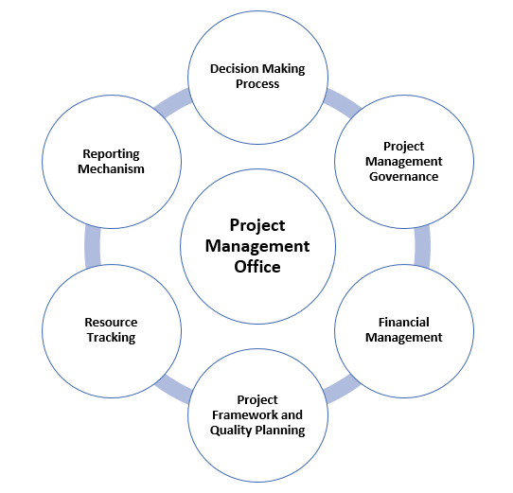
Characteristics - Project Management

Slide 86
Characteristics - Project Management
Scope: defines what will be covered in a project.
Resource: what can be used to meet the scope.
Time: what tasks are to be undertaken and when.
Quality: the spread or deviation allowed from a desired standard.
Risk: defines in advance what may happen to drive the plan off course, and what will be done to recover the situation.

Slide 87
Feasibility Study
A feasibility study is an analysis that takes all of a project's relevant factors into account—including economic, technical, legal, and scheduling considerations—to ascertain the likelihood of completing the project successfully.

